Slide 1

OWASP London 4th December 2014

Slide 2
Agenda
Networking, food and refreshments
Welcome Justin Clark
Offensive OSINT Christian Martorella and Zigor Zumalde
OWASP Roundup Colin Watson
OWASP Testing Guide v4 Matteo Meucci
Networking

Slide 4
OWASP Roundup
Past conferences
Project updates
AppSec EU 2015
Supporters
Christmas gift
Close

Slide 5
Past AppSec Conferences
AppSec EU 2014
23-26 June, Cambridge UK
https://2014.appsec.eu/
https://www.youtube.com/playlist?list=PLpr-xdpM8wG_KHsxepT9o6trkqDELhr3_
AppSec USA 2014
16-19 September, Denver USA
http://2014.appsecusa.org/2014/
http://2014.appsecusa.org/2014/about/live-streaming/
https://www.youtube.com/playlist?list=PLpr-xdpM8wG8jz9QpzQeLeB0914Ysq-Cl

Slide 6

Testing Guide
Version 4
17th September 2014
https://www.owasp.org/index.php/OWASP_Testing_Project

Slide 7

Proactive Controls
Version 1
10th March 2014
https://www.owasp.org/index.php/OWASP_Proactive_Controls

Slide 8
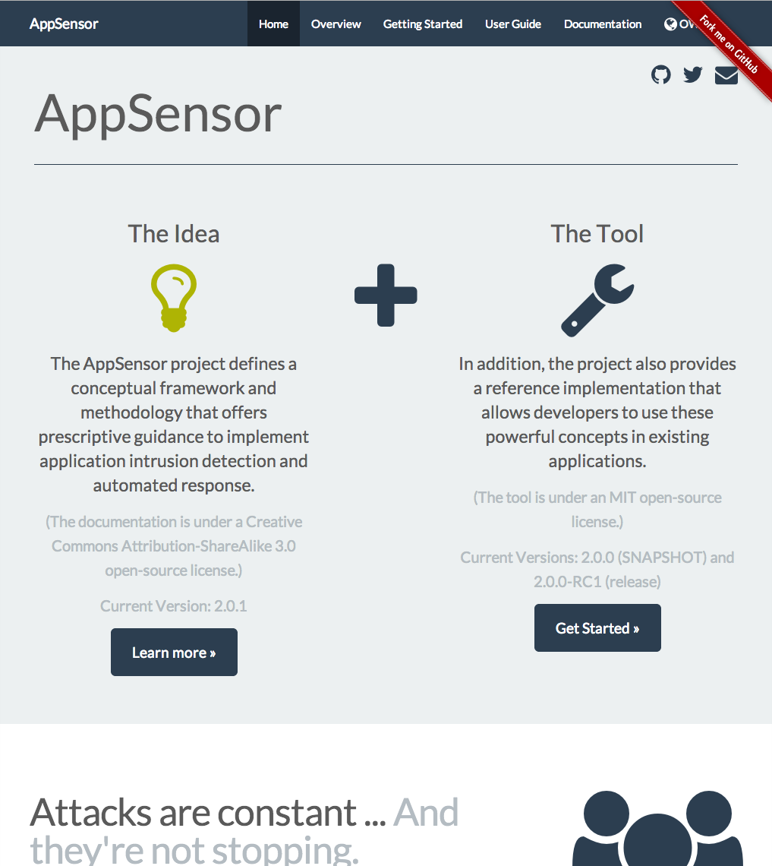
AppSensor
Website
11th September 2014
http://www.appsensor.org/
Reference implementation
4th November 2014
v2.0.0 RC2 https://github.com/jtmelton/appsensor/releases/tag/v2.0.0-RC2

Slide 9
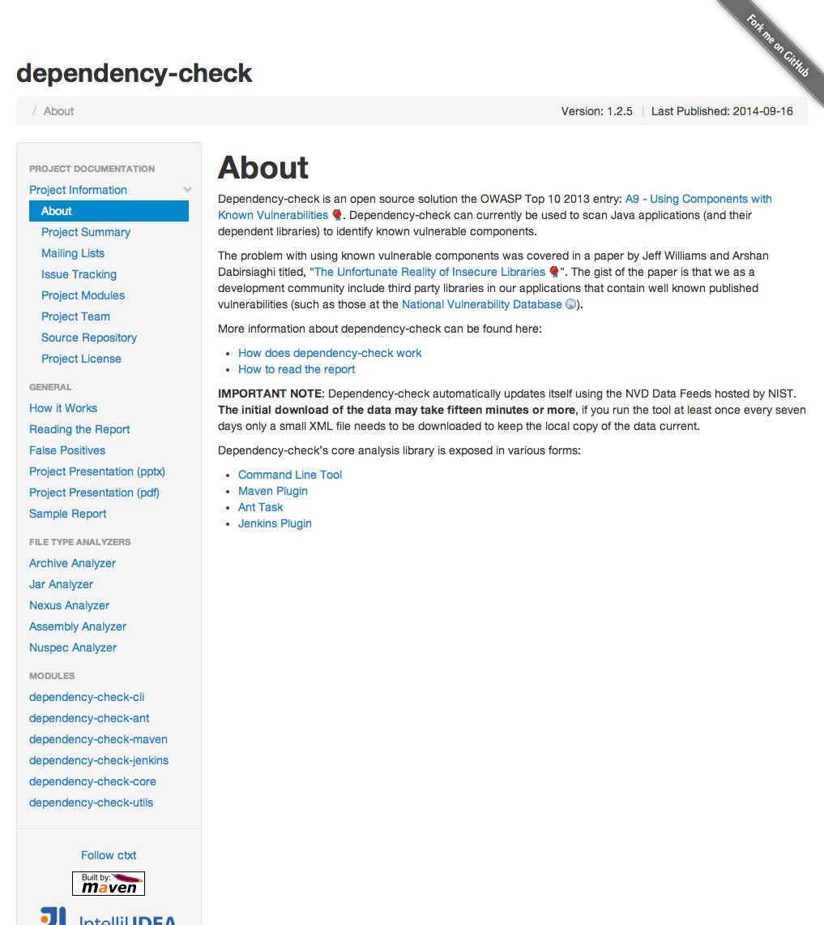
Dependency Checker
Version 1.2.6
17th November 2014
http://jeremylong.github.io/DependencyCheck/

Slide 10
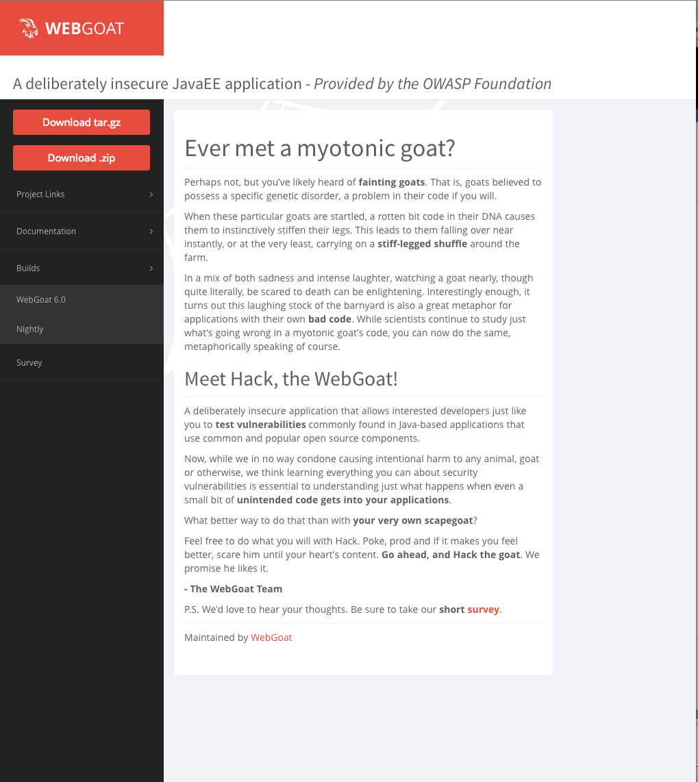
Web Goat
Version 6.0
12th September 2014
http://webgoat.github.io/

Slide 11
Cyber Security Week
OWASP London Cyber Security Week
Workshops, talks and hackathon
Startup focus
Free to all
Held at Google and UCL
26-30 January 2015

Slide 12

AppSec EU 2015
Envisioned program
4 applied talk tracks: Builder, Breaker, Defender, CISO
1 research track
19-22 May 2015
Amsterdam RAI The Netherlands

Slide 13
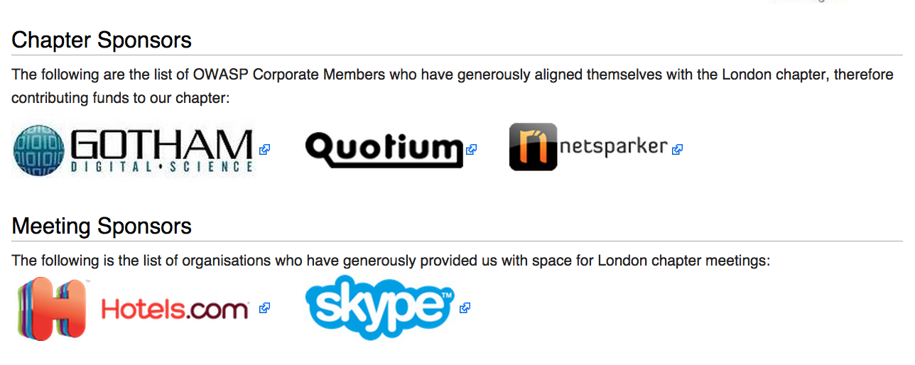
London Chapter Supporters

Slide 14

Thank You
Speakers
Christian Martorella
Zigor Zumalde
Matteo Meucci
Chapter Leaders
Justin Clarke
Tobias Gondrom
Hosts for this evening
Skype
Attendees

Slide 15
OWASP
Volunteers
Project leaders
Project contributors
Chapter leaders
Members
Corporate supporters
Individual members
Other supporters

Slide 16
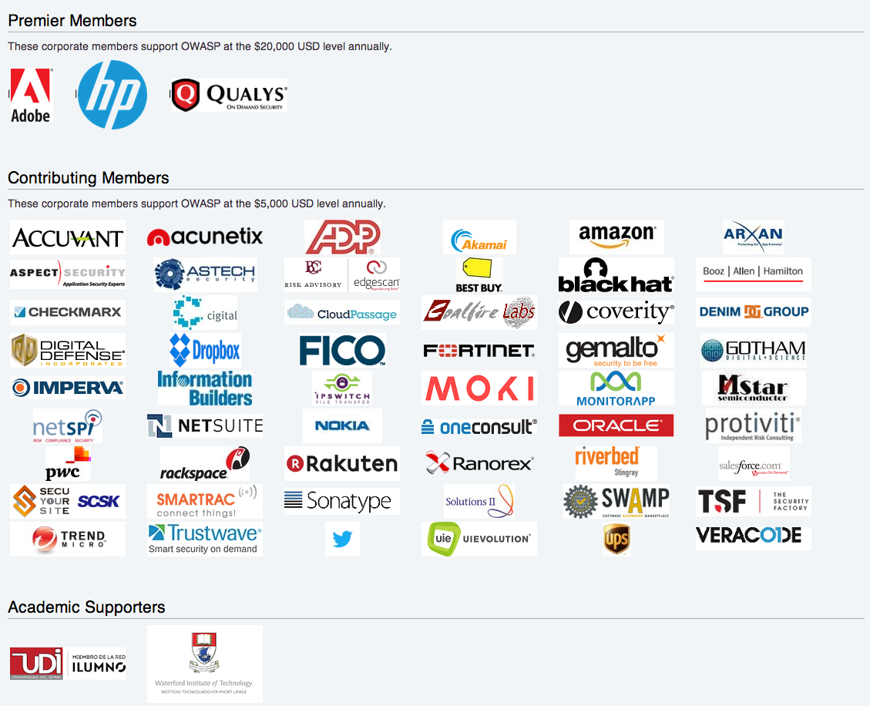
Corporate Sponsors

Slide 17
Something Different
Top Ten Risks
Injection
Broken Authentication and Session Management
Cross-Site Scripting (XSS)
Insecure Direct Object References
Security Misconfiguration
Sensitive Data Exposure
Missing Function Level Access Control
Cross-Site Request Forgery (CSRF)
Using Components with Known Vulnerabilities
Unvalidated Redirects and Forwards
Top Ten Proactive Controls
Parameterize Queries
Encode Data
Validate All Inputs
Implement Appropriate Access Controls
Establish Identity and Authentication Controls
Protect Data and Privacy
Implement Logging, Error Handling and Intrusion Detection
Leverage Security Features of Frameworks and Security Libraries
Include Security-Specific Requirements
Design and Architect Security In

Slide 18



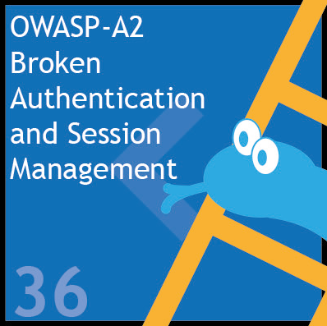

Another Game

Slide 19
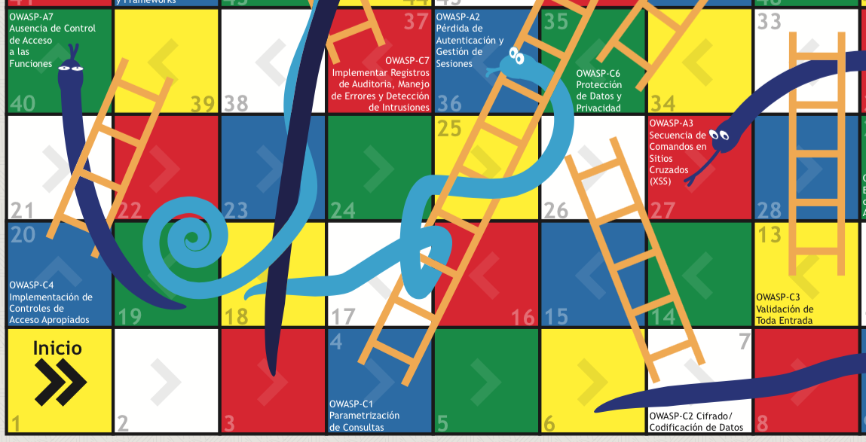
Web Applications: ES

Slide 20
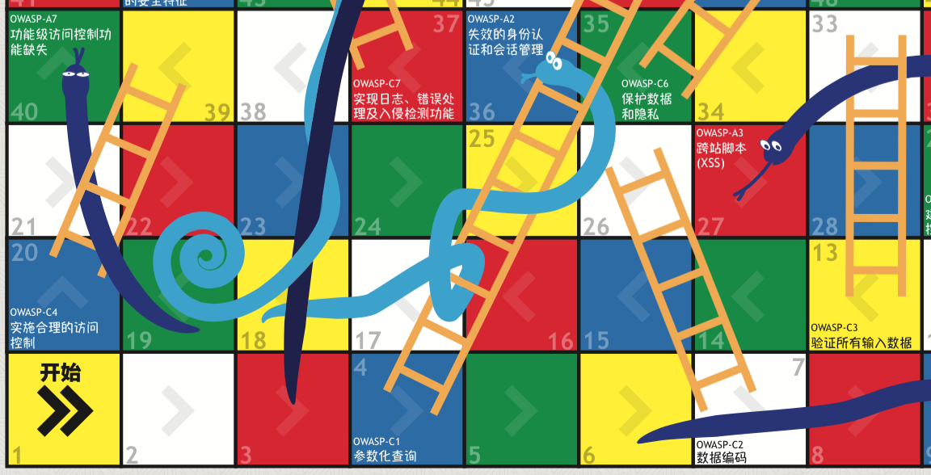
Web Applications: ZH

Slide 21
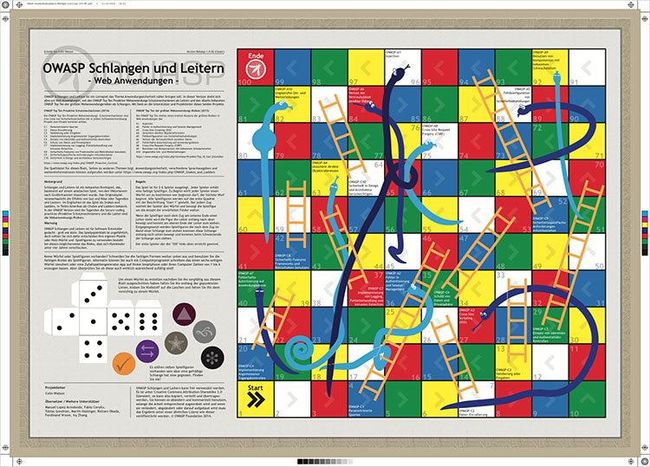
Web Applications: DE

Slide 22
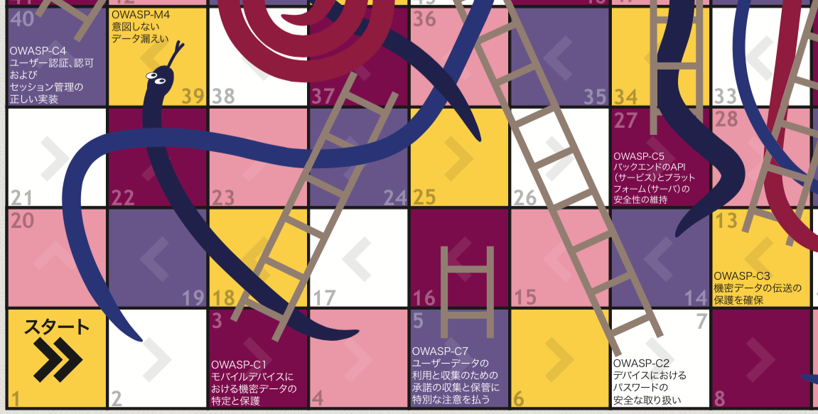
Mobile Apps: JA

Slide 23
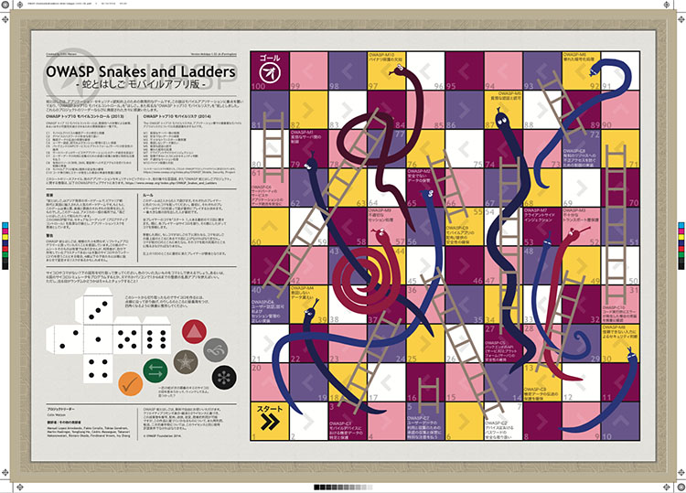
Mobile Apps: EN

Slide 24
Print Your Own
Adobe PDF A2 print quality
Adobe Illustrator Source
Web Applications DE, EN, ES, FR, JA, ZH
Mobile Apps EN, JA

Slide 25
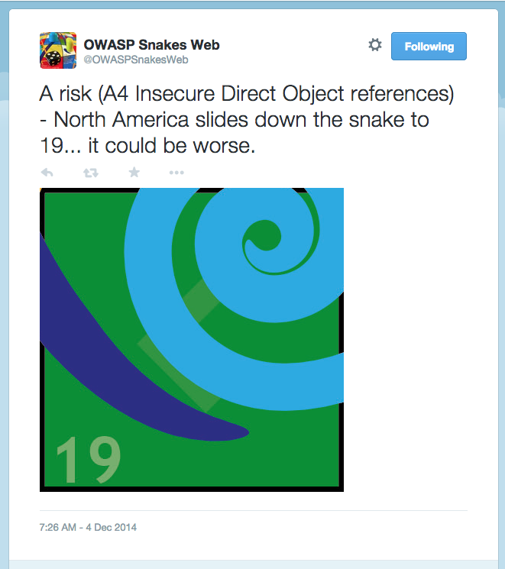
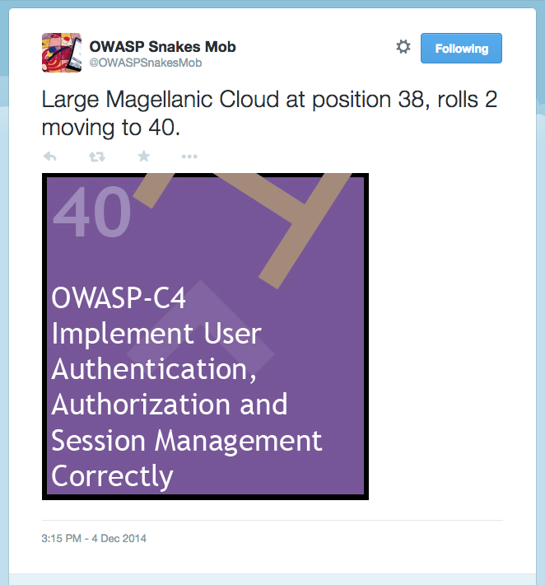
Twitter

Slide 26
Staying in Touch
Chapter page
https://www.owasp.org/index.php/London
Mailing list
http://lists.owasp.org/mailman/listinfo/owasp-london
Twitter Facebook
http://twitter.com/owasplondon https://www.facebook.com/OWASPLondon
Elsewhere in the UK
Birmingham, Bristol, Cambridge, East Midlands, Leeds, Manchester, Newcastle, Royal Holloway, Scotland, South Wales, Suffolk

Slide 27

The Melton Mowbray
18 Holborn

